Slide 1

April 24th , 2018, Brussels, EU cyber-industry - Internet of Things and Industry 4.0
ENISA Industry collaboration event
Thomas Walloschke
Chair WG11 Smart Manufacturing Industry, Steering Board Member

Slide 2
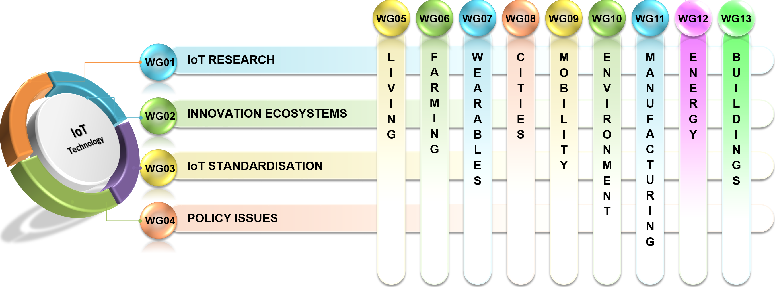
AIOTI WG Cross Cutting Structure
Horizontal WGs
Vertical WGs

Slide 3
AIOTI Mission
Develop IoT ecosystems across vertical silos including startups and SMEs.
Identify, communicate and champion EU spearheads to speed up the take up of IoT.
Mapping and bridging global, EU and Members States’ IoT innovation activities.
Gather evidence on market obstacles for IoT deployment in a Digital Single Market context.
Shape research policy to foster experimentation, replication and deployment and to support

Slide 4




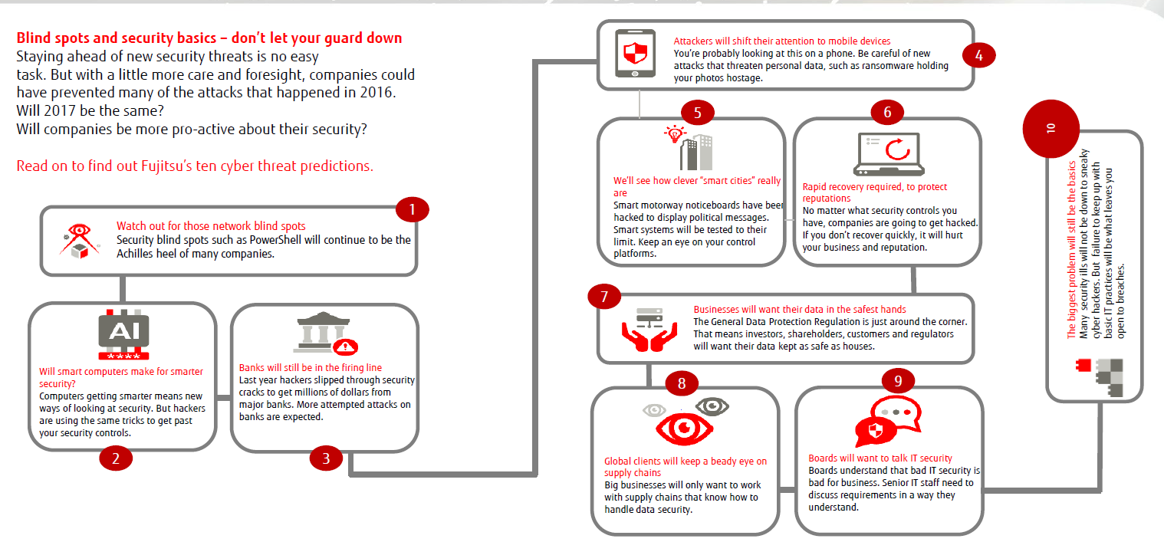



AIOTI Working Group
WG11: Smart Manufacturing Industry
Industrial IoT (IIoT)
Action Line 1
Action Line 2
Governance
Alignment
Security
Innovation
H2020
AIOTI
ALLIANCE FOR INTERNET OF THINGS INNOVATION

Slide 5

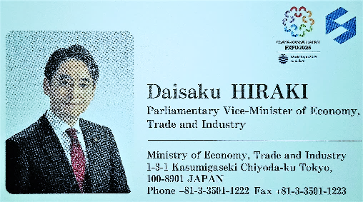
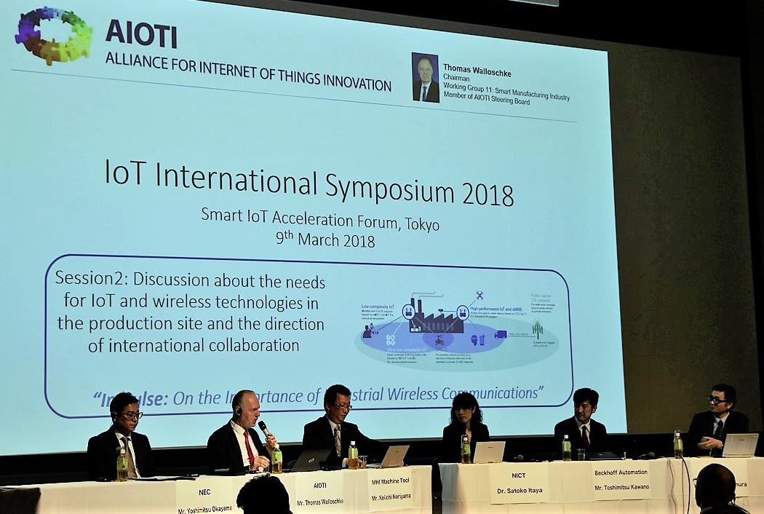
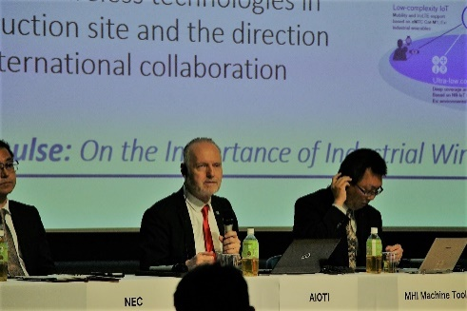
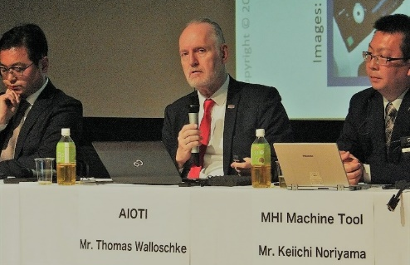
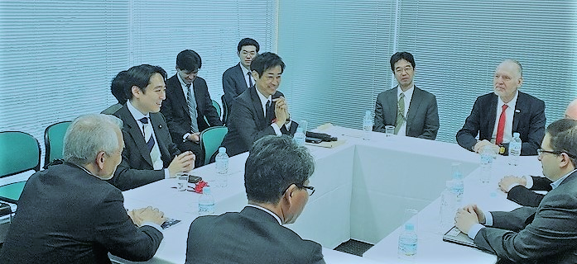
AIOTI@IoT International Symposium 2018 (March 9th)
Meeting with the Parlamentary Vice-Minister of Economy, Trade and Industry (METI, Japan), Mr. Daisaku Hiraki
“…one of the concrete collaboration between AIOTI and ITAC would be to share good practices and update each activities though this kind of symposium..” Ministry of Internal Affairs and Communications (MIC)

Slide 6
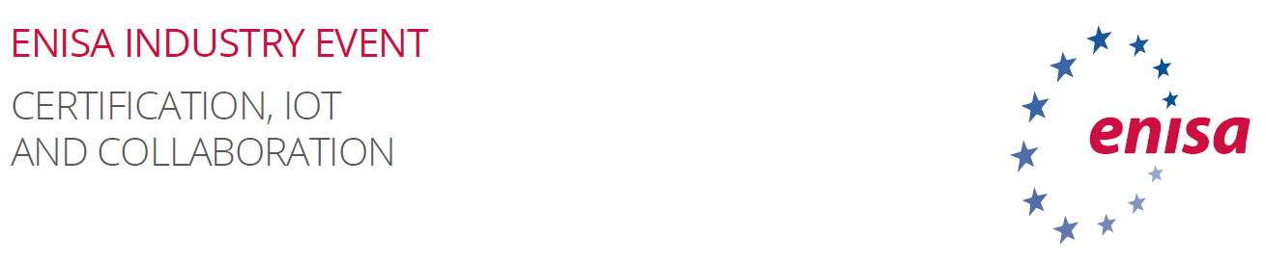

0. Mission and Objectives
IoT and Industry 4.0
View on the EU certification proposa
Future challenges of IoT and Industry 4.0
Maturity of EU Cyber Security Market

Slide 7
0. Mission and Objectives
Mission
  “Certification” and the ‘Internet of Things’
  “Interconnectivity” of ENISA Industry Event participants
  Alliance for Internet of Things Innovation (AIOTI )
    Comments on certification
    Not doing certification
Objectives
  “To commonly define actions and/or next steps that will contribute to developing the full potential of SMEs representing EU cyber-industry”
  “To translate these actions, or next steps, into a common position to be actively communicated with relevant strategic stakeholders”

Slide 8

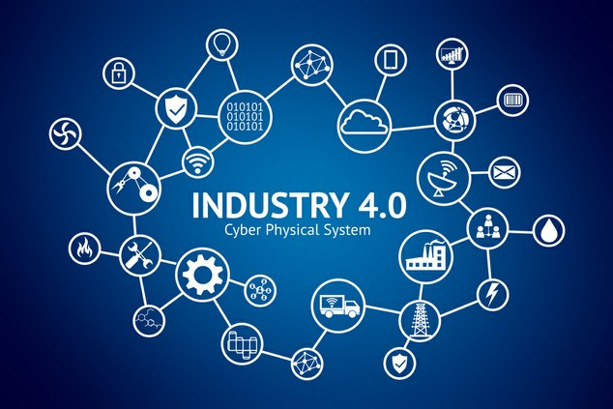
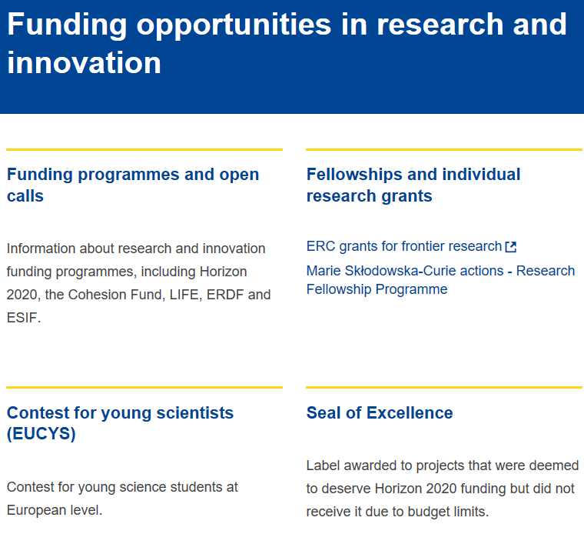
1. IoT and Industry 4.0
Most relevant developments, opportunities on IoT and Industry 4.0:
Involvement of relevant SMEs in NIS/Cybersecurity activities like supply chains
Relevant funding, subsidy programs, activities

Slide 9
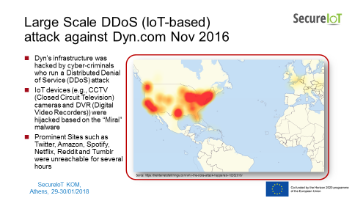
2. View on the EU certification proposal
Smart Manufacturing Industry
Stuxnet & Co, Mirai and next generation IoT botnets do mirror the need of minimum industrial standards in the IoT supply chain.

Slide 10
2.1 Cornerstones of ‘Trusted IoT Label’
No one-size-fits-all:
Different application require different controls and therefore different label semantics based on the customer’s security preferences in order to pro-vide an added value.
Don’t put the cart before the horse:
Claims shall focus on what shall be achieved, how to do it needs to be left to the product manufacturer.
There is no silver bullet:
Single security features are not the universal answer but an appropriate solution will always be a combination of measures tailored to the application domain and context of use.
Application profiles give orientation:
Intended use has to be understood, like “operation on the open Internet” and application profiles like “Internet-ready” are meaningful
Market surveillance is crucial:
A label is only meaningful if conformance can be objectively verified and false conformance claims can be prosecuted effectively.

Slide 11
2.2 Regulation - Pro‘s and Con‘s (1)
The industry should properly implement and update what can be secure.
Pro's:
  Regulation (and certification is one part of it) can help industry to implement a minimum of standards on the whole IoT supply chain, which will lead in more security
  Regulation will raise awareness of stakeholders to implement and security in their products (e.g. as GDPR raising awareness in privacy)
  Regulation will protect market players from being cheated by unfair parties gaining competition & by lower costs of unsecure products

Slide 12
2.3 Regulation - Pro‘s and Con‘s (2)
The industry should properly implement and update what can be secure.
Con's:
  Certification in security cannot used to guarantee seal for a safe product - but may be misunderstood by consumers in that way
  Certification is a cost factor - inferior startups and sme's but favor large enterprises
  Certification guidelines cannot be adopted as fast as the market progess and are always out dated

Slide 13
2.3 Regulation - Pro‘s and Con‘s (3)
The industry should properly implement and update what can be secure.
Recommendations:
  Regulation similar to the Medical Devices Directive, in which industry can classify IoT applications into risk classes ranging from not critical (harmful) to critical (lethal).
  Products with a low risk class can be documented and evaluated by the industry itself.
  High-quality applications require certain internal and external audits.

Slide 14
2.4 NLF and CE Marking and Declaration of Conformity
Using the New Legislative Framework (NLF) Conformity Assessment Modules are a perfect toolbox for different product sectors and different risk levels.
The CE Marking and the Declaration of Conformity are the visible parts of a flexible compliance scheme successfully implemented and used in EU for over 30 years, in almost all industry sectors.
This approach establishes a same level playing field within the EU.

Slide 15
3. Future challenges of IoT and Industry 4.0
Industrial security, without cyber security-by-design, security by defaults is no longer acceptable
  Otherwise there is a mutual "danger from attacks"
  There is also a fundamental need for trustworthy, secure communication
Long investment periods, traditionally slow technological change cycles in industry and the associated inertia
Establishing in Europe and globally the same scheme of trustworthiness and identity (e.g. to foster M2M contracting)
Secure cross-fields, -companies, -countries, -continents, and -sectors commination = Core Industry 4.0 requirement
=> “Interconnectivity’”of Industry participants
Convergence of autonomous systems (vehicles/cars/everything)
NIS based IIoT, OT & Security requirements
(locally and cloud-based)

Slide 16
3.1 Excursion : Avoidance of Stumbling Blocks
The number of Industry 4.0 or IIoT projects, as the data foundation for the future projects of many industrial companies, has increased in the last three years.
However, despite the great enthusiasm, these projects have a very high integrative character and their requirements should not be underestimated.
Here are some insights into seven most important stumbling blocks:

Slide 17
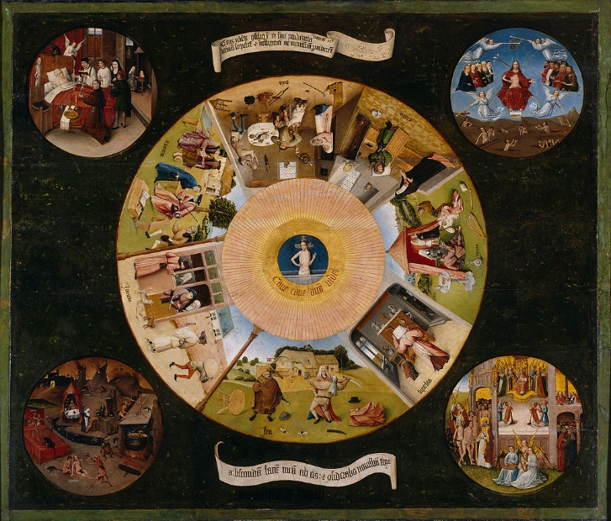
3.2 Excursion : The Seven Mortal Sins of I40 and IIoT
Observations
By Hieronymus Bosch
Sins
Pride: totally easy
Greed: too little time
Laziness: lack of tests, agile “planning”, inconsistent management
Lust: quick satisfaction without sustainability
Anger: cancel the user from the project equation
Envy: the "soft" factor is underestimated in many places
Gluttony: all in one go
Source: https://de.wikipedia.org/wiki/Bilder_von_Hieronymus_Bosch#/media/File:Hieronymus_Bosch-_The_Seven_Deadly_Sins_and_the_Four_Last_Things.JPG

Slide 18
4. Maturity of EU Cyber Security Market
Future Challenges of IoT
IIoT and I4.0 are different - but will align
European I40 initiatives not always aligned
Security results have already broken into many parts - the effort to fix them is a long story.
Industrial networks and systems to be based on industrial standards like IEC 62443 (Industrial Security)
Digital transformation takes a global understanding of future industrial requirements
BTW: How to take into account China Cybersecurity Law (CSL), e.g. Data Storage Locations, Exchange, Encryption, DRM, etc.?

Slide 19
5. Takeaway: Developments & Business Opportunities
Understanding of high innovation speed and excellence in the production of easy-to-use, secure and powerful products based on secure IIoT and advanced I40 processes..(link)
Trustworthiness of products, solutions, and communication is a key issue for industries and their customers. The integrity of the value chain is necessary, such that end users can have confidence in its security.
Worldwide harmonization: International trade regulations need to be transparent and harmonized. There should not be excessive examination and censorship by governments and secure international industrial cooperation facilitated. It is not feasible for single countries to work in isolation regarding security in global IIoT/Industrie 4.0.
Supply structures are spread across a variety of countries. Machines and plants are sold all over the world. Neither the business sphere of global companies, nor the cyber-attacks themselves stop at international borders.
A harmonized approach based on international standards at international level is the only way to achieve consistent and trustful security levels, including small and medium-sized companies.
https://www.plattform-i40.de/I40/Redaktion/DE/Downloads/Publikation/Secure-Industrial-Internet-of-Things.pdf;jsessionid=D514264472E673CC0ABF352F35C7F2C9?__blob=publicationFile&v=4

Slide 20
Many thanks for your patience!
We very much look forward
to active collaboration
https://aioti.eu/
Contact: Thomas Walloschke at
Thomas.Walloschke@ts.fujitsu.com

