Slide 1
Why commercially viable cross-domain use cases will drive innovation and horizontalization of IoT-enabled smart cities?
Panelists
Keith Dickerson, AIOTI and Climate Associates (@dickerk2)
Martin Brynskov, OASC and Aarhus University (@brynskov)
Omar Eloumi, AIOTI and Nokia (@oelloumi)

Slide 2
Outline
Introduction
Cross-applications use cases
What next?

Slide 3
IoT-enabled smart cities, where do we stand?
Read also: http://news.itu.int/iot-enabled-smart-cities-3-priority-areas-2018/
Connectivity, plenty to choose from
No ‘one-size-fits-all’ connectivity solution
Recent advancements in Low Power Wide Area (LPWA) are filling a major connectivity gap
Choices should, however, be made with caution. Cities should avoid having to manage or use too many different types of networks
Open data is starting to happen
Data is the oil that will fuel the innovation for application developers
Several cities are starting to open access to historical data in different file formats
To move beyond static files, more effort is needed to provide datasets, including as they are generated, and use a uniform API for all city data
City-funded projects are often turn-key
Cities buy a solution to solve a specific problem
Projects will yield greater value if cities pay close attention to architectures and the component reusability of platforms during the procurement processes

Slide 4
IoT-enabled smart cities, where do we stand?
Read also: http://news.itu.int/iot-enabled-smart-cities-3-priority-areas-2018/
Commercially viable cross-application (and cross-domain) use cases are emerging
Cross application and cross-domain use cases will come to form market drivers for horizontal integration, changing procurement processes in such a way that component re-usability and data sharing will be integral to such processes
Projects will only achieve significant scale if supported by a clear business / value proposition
Proving a clear business case can be challenging for new innovations for which little historical evidence is available
Identified risks should be viewed in comparison with the risk of not innovating and being left behind in emerging and evolving markets
Key to the is the identification of commercially viable or economically sustainable along with clear guidelines for cities to replicate such use cases
No single IoT platform will dominate
Smart Cities will be built on a combination of infrastructure from different players
No single IoT platform will dominate
Increasing need for IoT platforms to exchange data to address the requirements of cross-application use cases

Slide 5
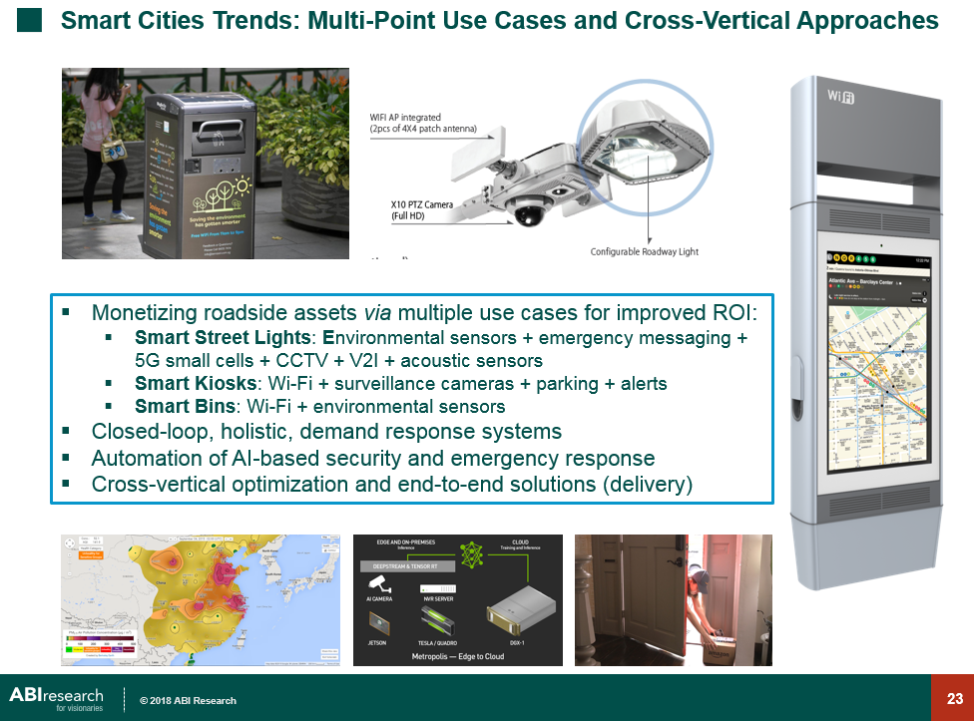

Slide 6
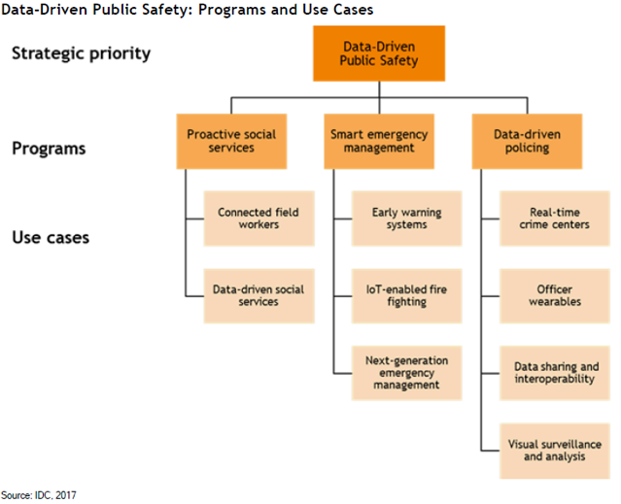
Data driven public safety use cases

Slide 7
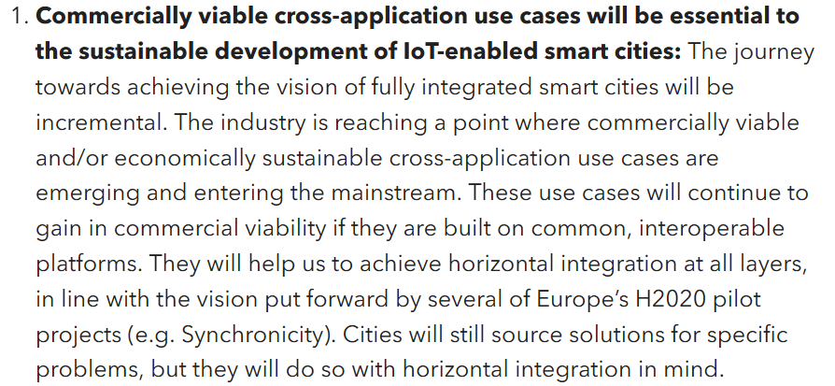
Priority area 1

Slide 8
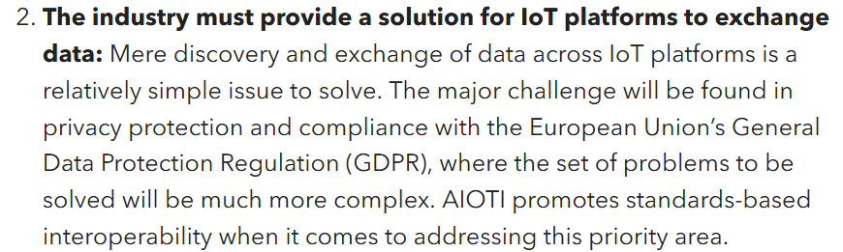
Priority area 2

Slide 9
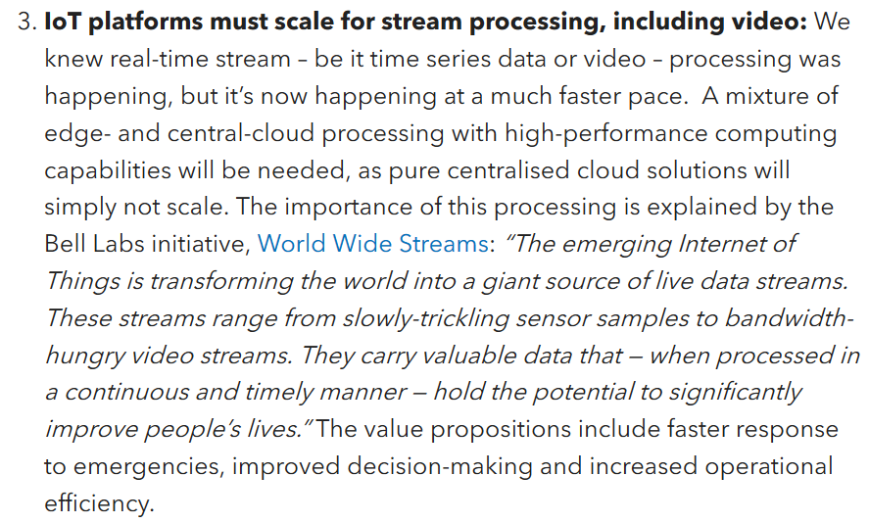
Priority area 3

Slide 10
Cross application use cases

Slide 11
Outline
Smart City Replication Guidelines
What is Cross-Domain?
What is Commercial Viability?
Sources of Best Practises in Cross-Domain Use Cases
Examples of Cross-Domain Use Cases
Requirements for Interoperability of Data between Domains
Standards Requirements of a Horizontal Platform
Recommendations

Slide 12
Motivation
“the objective is to build a case for a future proof horizontal approach that brings value to cities and citizens and derive related requirements which can drive future work on guidelines”
– Omar Elloumi

Slide 13
How to replicate Smart Cities solutions
Best Practises
Common (Cross-Domain) Use Cases
Capability Model
Benchmarking / KPIs
Interoperability – Vertical and Horizontal
Requirements for a Horizontal Platform
Requirements for Standards (Horizontal and Vertical)
Profiling: taking a solution that has worked in one city and applying it in a range of other cities with different characteristics
Notes:
A reminder of the tools and techniques that can be used to help replicate smart city solutions

Slide 14



















What is Cross-Domain?
Cross-domain uses cases require access to information from different domains that is normally held in separate silos
Pollution levels
Smart travel
Management Control
Public Safety
Education
Street Light Management
TV
Fleet Management
VoD
Video
Conferencing
HealthCare
KIOSK
Access
Control
Parking
Control
CCTV
Monitoring
Waste
Management
Facilities
Control
Power
Control
Light
Control
Notes:
This is a picture from ETSI Technical Report 103 290 “Machine-to-Machine communications (M2M); Impact of Smart City Activity on IoT Environment” which shows possible domains in a smart city, each with their own data-sets and information sources.
A cross-domain (or cross-cutting) use case is one which, to be realised effectively, requires access to information normally contained in different (possibly legacy) silos or data-sets. Smart Cities, because of their wealth of different domains, provide some of the best examples of cross-domain use cases.

Slide 15
Examples of Cross-Domain Use Cases
Smart Lighting so that street lighting is only provided when needed.
Smart Parking and Assisted Living to ensure that parking spaces are available for health professionals when required.
Smart Energy and Smart Mobility to ensure that power is available to charge electric vehicles when required.
Air Quality Monitoring and Traffic Routing so that traffic can be routed over less polluted routes.
Notes:
Here are some simple examples of cross domain use cases so you can see the concept.
Examples of these will be provided in more detail later.

Slide 16
But which are commercially viable or economically sustainable?
Is there a real city-driven need for the solution defined by the use case?
Is the solution deployed in a city (or preferably more than one city) today?
Does the solution have real users (rather than test users)? Roughly how many are there? Are they paying to use the solution?
Is the solution economically sustainable? Who is providing the funding (what type of stakeholder) to maintain the service and how is the revenue shared?
What is the value proposition? Could it be funded from a mixture of private and public funding? Is there a regulation that provides the need for this use case?
What is impact on the CAPEX/OPEX of the stakeholders in a smart city?
What is the commercial complexity, in terms of the different suppliers and service providers, that need to come together to offer the solution?
Who are the actors providing data necessary to offer the solution?
Is the solution future-proof (e.g. does it rely on a network solution that is due to be phased out) and is it sustainable?
Notes:
To justify the implementation of a horizontal platform for smart cities the income from a cross-domain service must be sufficient to fund the extra costs of procuring it.
The problem with some of these simple cross-domain use cases is that in practice they may not be commercially viable or economically sustainable. Once the servers and other infrastructure has been set up by a project, there might not be sufficient money coming in to sustain it after the project that created it finishes, so the service is not maintained after the trial period.
How can we avoid this?
Apply these tests…go through list above.
It may be possible to modify a use case to involve different stakeholders and different funding sources to keep a service alive once the trial period has ended.

Slide 17












Best Practices: H2020 Smart City Lighthouse Projects
Notes:
Here are some sources of best practises for cross-domain use cases for smart cities.
The H2020 Smart City Lighthouse projects are exploring techniques for Replication of Smart City solutions and defining use cases, some of which are cross domain.
There are 12 project in total looking at things ranging from retrofitting of buildings to make them energy efficient to smart transport in order to reduce congestion and GHG emissions.
The slide should be updated with the lighthouse projects which started in 2018 but these have not got as far as defining their use cases yet.
For this study we’ve had input from Replicate, REMOURBAN, RUGGEDISED, Sharing Cities, Smarter Together and Triangulum.

Slide 18
H2020 Lighthouse (Leading) Cities
GrowSmarter: Stockholm, Cologne, Barcelona
IRIS: Göteborg, Utrecht, Nice
MAtchUP: Valencia, Antalya, Dresden
mySMARTLife: Nantes, Helsinki, Hamburg
REMOURBAN: Valladolid, Nottingham, Tepebasi/Eskisehir
REPLICATE: Bristol, San Sebastian, Firenze
RUGGEDISED: Umeå, Rotterdam, Glasgow
Sharing Cities: London (Greenwich), Lisbon, Milan
SmartEnCity: Vitoria-Gasteiz, Sonderborg, Tartu
SMARTER TOGETHER: Wien, Lyon, München
Stardust: Pamplona, Tampere, Trento
Triangulum: Manchester, Eindhoven, Stavanger
http://www.smartcities-infosystem.eu/sites-projects/projects
Notes:
…and here are the cities leading these lighthouse projects.
There is a wide spread of city locations across and beyond Europe so there will be a widespread diffusion of replication techniques.
Each project has at least 3 follower cities as well so the solutions will be replicated (under a different set of conditions) in a different set of cities.
A number of these have led to services which are sustainable after the end of the project.

Slide 19







Best Practises: H2020 IoT Large Scale Pilots
Management of Networked IoT Wearables – Very Large Scale Demonstration of Cultural and Security Applications – www.monica-project.eu
ACTivating InnoVative IoT smart living environments
for AGEing well - www.activageproject.eu
AUTOmated driving Progressed by Internet Of Things – www.autopilot-project.eu
Internet of Food and Farm 2020 - www.iof2020.eu
Delivering an IoT enabled Digital Single Market for
Europe and Beyond – www.synchronicity-iot.eu
User Engagement for Large Scale Pilots in the Internet of Things - www.u4iot.eu
CRoss FErtilisation through AlignmenT, Synchronisation and Exchanges for IoT – www.create-iot.eu
www.european-iot-pilots.eu
Notes:
The Horizon 2020 IoT Large Scale Pilots will also be very relevant to providing cross-domain use cases.
Clearly Synchronicity is very relevant to Smart Cities (and will be described later by Martin Brynskov) but it’s not the only one:
Monica for example plans to deploy 10,000 devices for monitoring health and fitness as well as providing new media opportunities.
Activage is looking at active and healthy aging and will be deployed across Smart Cites.

Slide 20






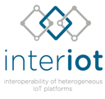


Best Practises: H2020 IoT-EPI Projects
www.european-iot-pilots.eu
Notes:
Other best practises can be found among the IoT projects in the H2020 IoT-EPI (European Platforms Initiative).
These are putting in place the enabling technologies for IoT to connect smart city domains.
The VICINITY project in particular has 4 pilot sites and around 23 use cases, some of which are cross-domain and 2 are included here.

Slide 21
Specific Cross-Domain Use Cases
Smart Lighting so that street lighting is only provided when needed.
Air Quality Monitoring, Traffic Routing and Road Pricing.
Monitoring Assisted Persons outside the Home.
Smart Parking and Assisted Living to ensure that parking spaces are available for health professionals when required.
Smart Street Lighting, Air Quality Monitoring and Pedestrian Safety.
Mobility inside the City.
Next Generation Emergency Services (Crowd Control and Emergency Response).
Notes:
There are other sources of cross-domain use cases but these are the one we will look at in more detail here.
List…

Slide 22

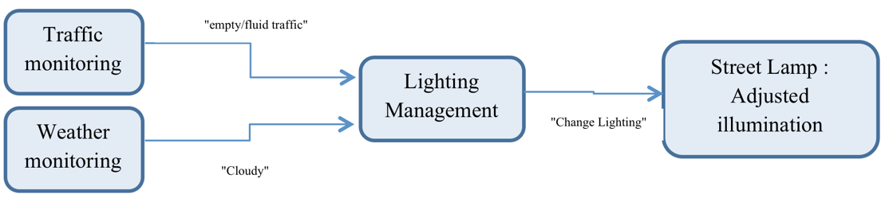
Smart Street Lighting (Bordeaux)
Notes:
Smart Street lighting is one of the simplest cross-domain use cases but one that is being commercially deployed in Bordeaux and other cities, although all the functionality might not be present yet.
The lighting in particular streets can be controlled depending on factors such as the amount of traffic using the street or the weather situation.

Slide 23
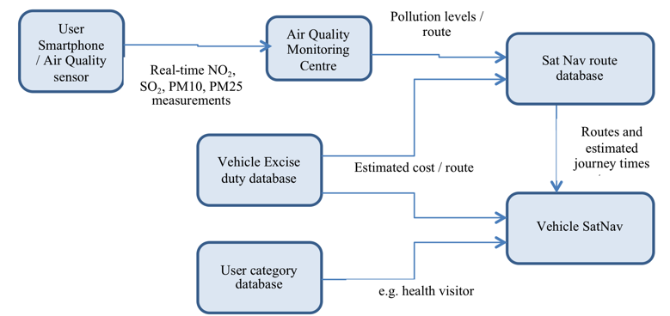
Air Quality Monitoring, Traffic Routing and Road Pricing (VICINITY)
Notes:
This is a modifed VICINITY use case.
It requires a dense network of air quality sensors, possibly provided by personal smartphones, which would make it possible to differentiate and select traffic routes for individual vehicles based on pollution levels in addition to the distance or time taken to traverse each route.
Here is the exchange of Information.

Slide 24
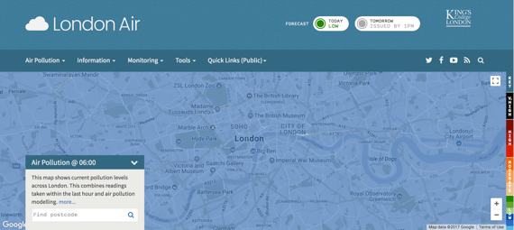
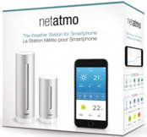
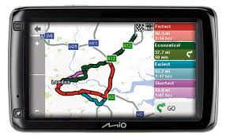
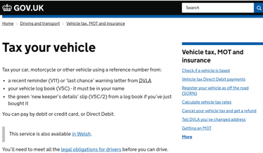
Data Sources
Smartphone with built in air quality sensor
Air Quality database
SatNav adapted to provide air quality-based routing
Vehicle Tax database
Notes:
Here are the sources of data for the use case.

Slide 25
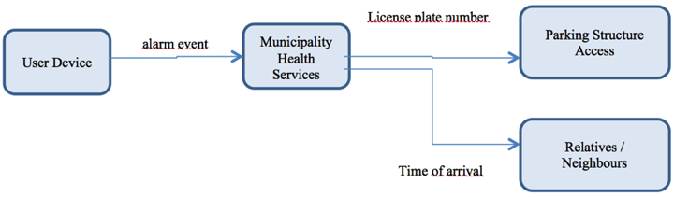
Smart Parking and Assisted Living (VICINITY)
Notes:
To enable incidents to be detected and emergency services to get to residential homes more quickly.
Deployed in the Municipality of Pilea-Hortiatis (Greece) which operates an eHealth at home pilot supporting around 50 registered homes in the municipality area. When one of the devices triggers an alarm, health care personnel are notified, a parking space is assigned, the license plate of the approaching car is white-listed and an estimated time of arrival is provided.

Slide 26


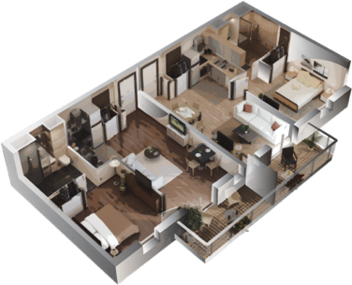




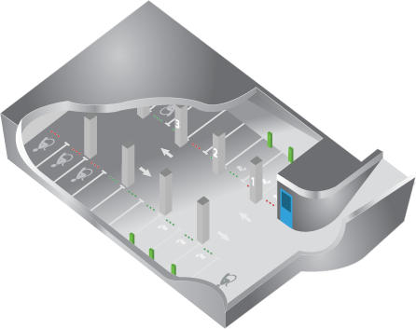



Smart Parking / Assisted Living
If an event is triggered from a wide range of data sources:
Assign parking space (booking, occupied, sign)
Notify health care personnel (mobile)
Whitelist licence plate of approaching car (ALPR)
Generate estimated time to arrival
Inform neighbours or carers
H2020 ICT-30
Public
Notes:
Here is one of the VICINITY use cases which is being deployed in Tromsø in Norway. It integrates smart parking and assisted living.

Slide 27
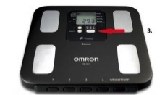

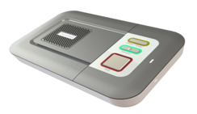
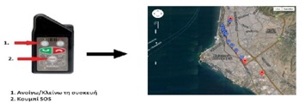
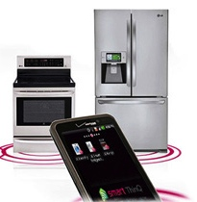


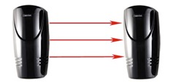
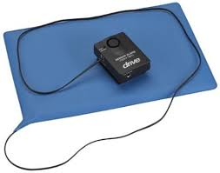
Data Sources
Weight monitoring device and pressure monitoring device
Communication device with automated dialling to a call centre
Wearable “Panic Button” and integrated fall detection
Wearable GPS positioning device for elderly people with dementia
“Smart” IoT connected drug dispenser and smart appliances (fridge, oven), allowing monitoring of elderly people activity within assisted living scenarios
Occupancy tracking devices for monitoring elderly people activities in house
Notes:
Here are the sources of data for the use case.

Slide 28
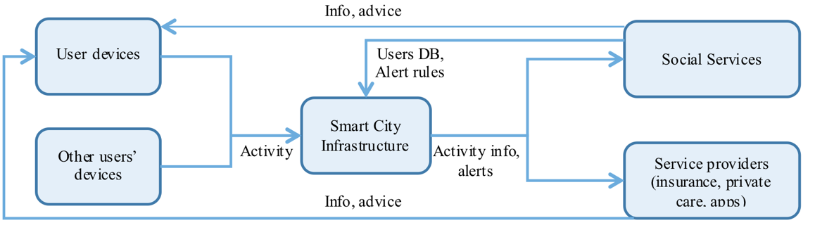
Monitoring assisted persons outside home (ACTIVAGE)
Notes:
Provides improved care to citizens, better quality of life (Quality of Life dimension).
The use case has two sub-cases:
A public service offered by municipalities to individuals
A private service offered by insurance companies and/or subscribers.
Types of information to be exchanged in this Use Case are:
System detects when elderly person goes outdoors and provides information about his/her physical activity: measuring activity, steps, distance walked… monitoring physical activity outdoors meters or km run a day
The system should be able to monitorise the users social activities (going out, chatting with friends, (outdoor activities, communication with other users (e.g. through phone line), etc.)
System provides information from monitoring of outdoor activity that contributes to detect cognitive impairment and pathologies: repetitive visits to bank, or nutrition habits based on diversity of places where the elderly person goes
System detects other elderly in the same situation and doing the same way or path, and alerts the elderly
Control of assisted elderly person within a security perimeter or route outdoors
System detects location of assisted elderly person outdoors and informs of it to caregivers.

Slide 29
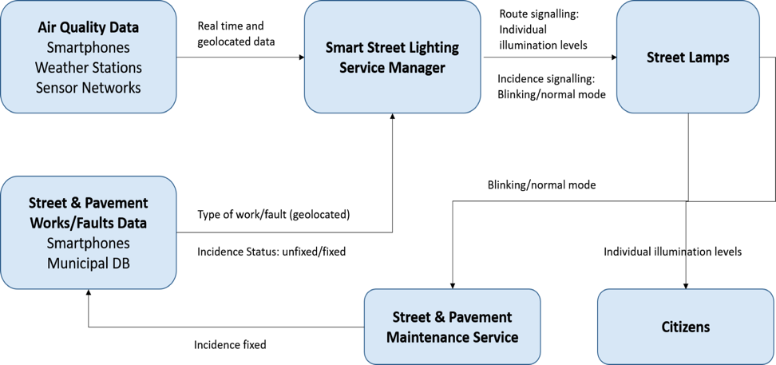
Smart Street Lighting, Air Quality Monitoring and Pedestrian Safety (Madrid)
Notes:
Pollution in the City of Madrid has become a serious issue, particularly for the citizens´ health (respiratory and cardiovascular diseases, allergies, cancer, etc.). The City Council is working on a hardening of the measures to be taken, to achieve healthy air quality levels and in accordance with the legislation; especially the ones related to traffic management - limiting the speed of vehicles or prohibiting to park- since it’s responsible of most of the total emissions. On the other hand, it is also desirable to reduce the number of accidents caused to pedestrians due to maintenance works and faults in the streets. Focused in these two aspects, CeDInt-UPM has deployed a pilot in the International Excellence Campus that UPM has in Montegancedo as Testbed for the city of Madrid.
In order to mitigate air pollution effect on citizens, this application aims to guide/recommend pedestrian alternative routes (at nights) according to pollution levels in the area and considering the existence of street & pavement works/faults. The Smart Street Lighting Service Manager (SSLSM) gathers air quality parameters based on static (weather stations, sensor municipal and collaborative networks) and mobile (smart phone users) sources. Besides, it collects street & pavement works/faults data from municipal sources and citizens involvement (smartphones). The SSLSM indicates the alternative routes by regulating the illumination level of each street lamp (e.g. the best route will present the highest light intensity), and signals the street & pavement works/faults setting the nearest street lamp on blinking mode, preventing accidents and helping the maintenance service to locate the incidence.

Slide 30
Data Sources
Weather stations capable of monitoring, among others, air quality parameters such as CO₂ or NO₂.
Air Quality wireless sensors equipped with ozone, particulate matter, carbon monoxide, sulphur dioxide, and nitrous oxide sensors.
Smartphones with two different applications: a) to continuously monitor and send air quality data; b) to register and send works/faults at streets and pavement.
LED street lamps equipped with communication and control devices.

Slide 31
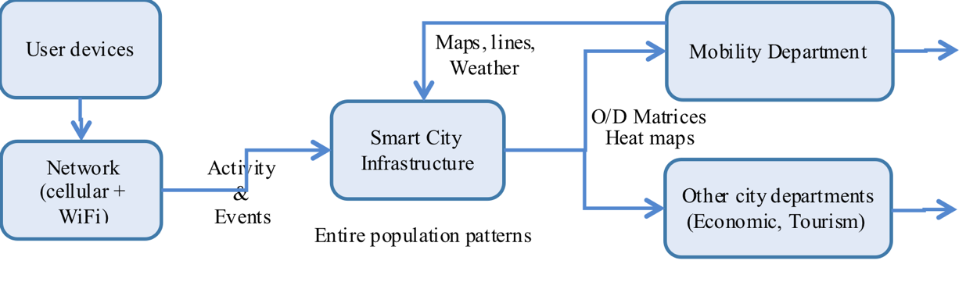
Mobility inside the city (REPLICATE)
Notes:
The collection of telecom traces and events (handovers in cellular networks, connections at wifi hotspots) to be used by the mobility department to create origin-destination matrix in near-real time, to gradually advance towards real time in the future. Specific treatment of key aspects: security/privacy of information, data governance, quality of service and standardization / interoperability.

Slide 32
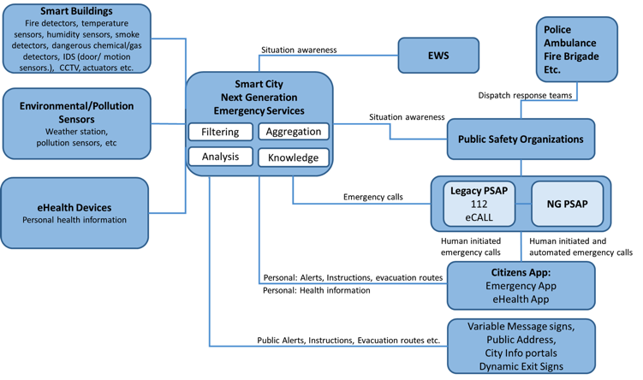
Next Generation Emergency Services (NGES)
Notes:
A smart building (private and/or public) equipped with smart sensors (temperature, smoke detectors, humidity sensors, gas detectors etc.) monitor parameters of interest
Smart environmental sensors that measure environmental parameters of interest (e.g. weather stations, pollution sensors etc.)
eHealth devices and/or eHealth apps that can share citizen health information
The functionalities of the Smart Cities NGES are:
Trigger automated emergency calls to PSAP, initiated by smart buildings, by smart environmental sensors, by eHealth applications and send real time information to PSAP for enhanced situation awareness of critical parameters
Control (automatic or semi-automatic) actuators to minimize the spread of an incident
Send information/instructions to the public/citizens within the vicinity of the incidents (inside a building, vicinity of a building, in critical area etc.) through various means (mobile apps, city information points, public address, variable message signs etc.), supporting evacuations (e.g. dynamic exit signs).
Dispatch information to disaster response teams
Receive information by citizens
Interoperate with Early Warning Systems

Slide 33
Data Sources
Smart buildings: Fire/smoke detectors, temperature sensors, humidity sensors, chemicals/gas detectors, intrusion detection systems, CCTV, actuators etc.
Environmental and pollution detection: wind speed, temperature, humidity, rain fall, ice, pollution, air quality, water levels etc.
eHealth devices: Personal health information.
Citizens Apps: Information from emergency area, personalised information.

Slide 34
Recommendations
Cities need to think horizontally during procurement, only then can they master the total cost of ownership for IoT use cases that are increasingly cross-application and cross-domain.
Proving a clear business case can be challenging for new innovations for which little historic evidence is available. As a consequence, replication and experience sharing among cities are key to overcome the long learning curves needed to understand the cost/benefits of such use cases.
Ultimately a horizontal approach is about building a robust data infrastructure which provides the necessary conditions for a wide range of applications to be deployed and to create value to the city in many ways.

Slide 35
Bibliography
ETSI TR 103 290 “Machine-to-Machine communications (M2M); Impact of Smart City Activity on IoT Environment”
Draft ETSI GR CIM 002 “Context Information Management (CIM): Use Cases”
VICINITY D1.3 “Report on Pilot Sites and Operational Requirements”
Delivering an IoT enabled Digital Single Market for Europe and Beyond – www.synchronicity-iot.eu
http://www.smartcities-infosystem.eu/sites-projects/projects
EC DG Energy “Analysing the potential for wide scale roll out of integrated Smart Cities and Communities solutions”

Slide 36
What next?

Slide 37
What next?
Key elements of a new demand
Standards-based innovation and procurement across domains
A common technical ground based on minimal interoperability
Market validation through projects and open calls
Emerging standards
Events

Slide 38
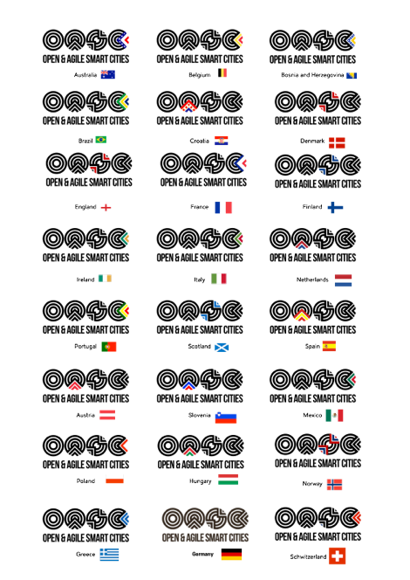

117 cities
24 countries
Europe, Latin America, Asia-Pacific
—
Global network of national networks
—
Demand-side
—
Mission: To create a global smart city market based on the needs of cities and communities
—
Council of Cities Coordinator: Ghent
BoD representative: Carouge (Geneva)

Slide 39
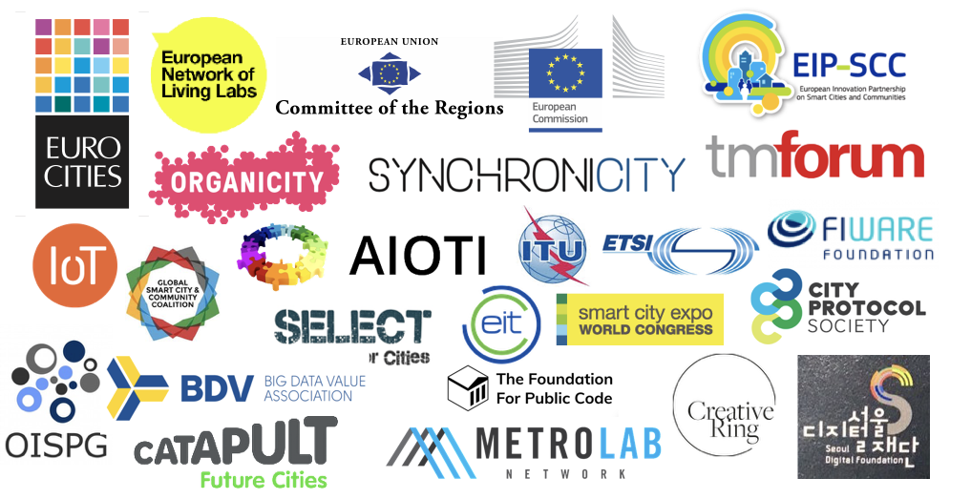

Slide 40


Slide 41



Slide 42
Minimal
Interoperability
Mechanisms
(MIMs)

Slide 43
Key Elements
Cross-domain interoperability is a main barrier (e.g. ETSI STF 505)
Incentives: Portability and replaceability (demand-side) vs. Replicability and reusability (supply-side)
Architecture Model vs. Interoperability Points and Mechanisms
(Pivotal) Interoperability Points (PPIs) – NIST/EIP-SCC
(Minimal) Interoperability Mechanisms (MIMs) – OASC/EIP-SCC
Existing standards and emerging specifications (e.g. ETSI NGSI-LD / GS CIM 004)
Validation through innovation actions and open calls
A joint IoT LSP open call ”package” of MIMs

Slide 44
A new demand
Standards-based innovation and procurement
Way ahead: Keep it simple!
Interoperability points and mechanisms

Slide 45




IoT Large Scale Pilots (LSPs): EU H2020 €104m
Project | Partners | Use Cases
ACTIVAGE | 49 | 8
AUTOPILOT | 44 | 5
IoF2020 | 70+ | 19
MONICA | 29 | 20+
SYNCRONICITY | 38 | 3 / 15+
Joint LSP ambitions: cross-domain, standards-based innovation and procurement,
through interoperability + replicability + reusability.

Slide 46


Standards-based innovation and procurement

Slide 47


38 partners
from 13 countries
and 3 continents
15m€ budget – 3m€ open call
Objective: Deliver a global market for IoT-enabled urban services in Europe and beyond
Cities & communities are inherently cross-domain (as are farms).

Slide 48
Common technical ground
Neutral branding (OASC – based on standards and consensus specifications)
Minimal Interoperability Mechanisms (MIMs)
  APIs
  Common data models
Reference implementation (standards-based)
Hosted cloud (optional)

Slide 49
SynchroniCity Architecture Model
IoT Management: to interact with the devices that use different standards or protocols making them compatible and available to the SynchroniCity platform.
Context Information Management: to manage the context information coming from IoT devices and other public and private data sources.
Data Storage Management: to provide functionalities related to the data storage and data quality interacting with heterogeneous sources.
Marketplace: to implement a hub to enable digital data exchange for urban data and IoT capabilities providing features in order to manage asset catalogues, orders, revenue management.
Security: to provide crucial security properties such as confidentiality, authentication, authorization, integrity, non-repudiation, access control, etc.
Monitoring and Platform management: to provide functionalities to manage platform configuration and to monitor activities of the platform services.
Baseline: SynchroniCity Cities/Reference Zones, OASC, FIWARE, EIP-SCC, NIST IES-CF.
Related standards: ITU-T SG20*/FG-DPM* (*drafts), ISO TC268.
Spec. doc.: Reference Architecture for IoT Enabled Smart Cities (D2.10)
http://synchronicity-iot/about

Slide 50
Interoperability Points
Interoperability Points represent the main interfaces that allow a city and applications to interact with SynchroniCity
Interoperability points are independent from the specific software components that realize them and can be implemented by cities in different steps to reach different levels of compliance
Interoperability Mechanisms are the actual specifications of the interfaces at the Interoperability points: they are standard APIs and guidelines that have to be implemented by a city in order to be compliant with the SynchroniCity framework

Slide 51
Interoperability Mechanisms
Interoperability Point | Description | Specification document (synchronicity-iot.eu/about) | Related Standards [and Baselines]
Context Management API | This API allow to access to real-time context information from the different cities. | Reference Architecture for IoT Enabled Smart Cities (D2.10) | ETSI NGSI-LD prelim API, OMA NGSI, ITU-T SG20*/FG-DPM*
Shared data models | Guidelines and catalogue of common data models in different verticals to enable interoperability for applications and systems among different cities | Guidelines for the definition of OASC Shared Data Models (D2.2) Catalogue of OASC Shared Data Models for Smart City domains (D2.3) | [SynchroniCity RZ + partner data models]
Marketplace API | It exposes functionalities such as catalogue management, ordering management, revenue management, SLA, license management etc. | Basic Data Marketplace Enablers (D2.4) Guidelines for the integration of IoT devices in OASC compliant platforms (D2.6) | [TM Forum API]
Security API | API to register and authenticate user and applications in order to access to the SynchroniCity-enabled services. | Reference Architecture for IoT Enabled Smart Cities (D2.10) | OAuth2
Data Storage API | This API allows to access to historical data and open data of the reference zones. | Reference Architecture for IoT Enabled Smart Cities (D2.10) | ETSI NGSI-LD, DCAT-AP [CKAN]

Slide 52
Emerging Cross-Domain Standards
ETSI ISG Context Information Management
  NGSI-LD (GS CIM 004 prelimAPI)
ITU-T SG20 (IoT and Smart Cities & Communities)
  Work item: Open APIs for smart cities
ITU-T FG-DPM (Data Processing and Management to support IoT and Smart Cities & Communities)
  WG1: Use Cases, Requirements and Applications/Services ← cross-domain
  WG2: Framework, Architectures and Core Components​
  WG3: Data sharing, Interoperability and Blockchain
  WG4: Security, Privacy and Trust including Governance
  WG5: Data Economy, commercialization, and monetization

Slide 53
Reference Implementation
SynchroniCity provides reference implementation components ready to be used by a city
Some of the proposed reference components are based on FIWARE ecosystem but this doesn't preclude the integration of the city through any other technology
The integration is API based implementing lightweight adapters among the existing platform interfaces and the SynchroniCity ones.
Cities are able to choose to install some of the proposed components in their local premises or to use them in “as-a-service” mode using specific cloud instances

Slide 54
Using the SynchroniCity Framework for standards-based innovation and procurement
1. Identify assets
First, a city needs to identify the assets that can and should be integrated with the SynchroniCity framework. These can include, e.g., data, (micro)services and IoT devices
2. Implement access API
Second, the access API can be implemented progressively, in different steps, depending on the technical infrastructure of the city. Security and Context Management API are the basic ones.
3. Align data models
4. Set your terms
Third, SynchroniCity curates a set of standard data models for different sectors/application domains, and supports a city in the adaptation of their own data models to the SynchroniCity ones with guidelines and dedicated tools
Finally, SynchroniCity offers a fundamental asset access and management framework, partly to ensure proper handling of ownership, terms and licenses, which is an essential element, partly because SynchroniCity has the aim to foster a market for IoT-Enabled urban services, including data. Towards these two objectives, SynchroniCity provides a common “marketplace” in which digital assets can be offered to public and private stakeholders, with or without monetisation.

Slide 56
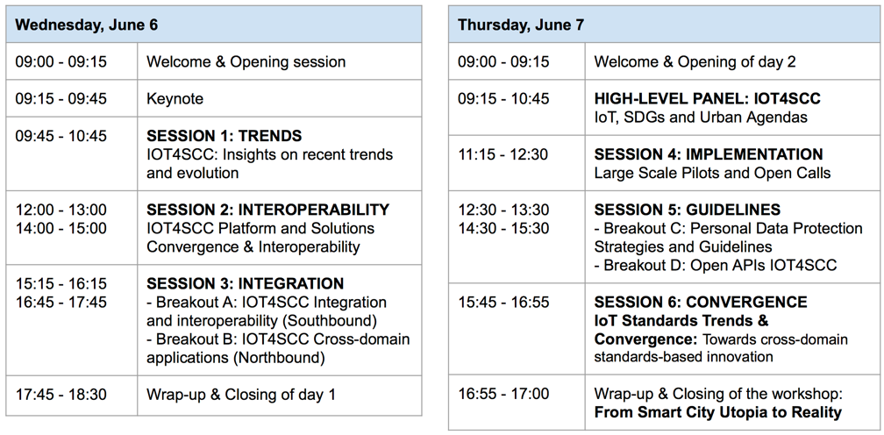

IOT4SCC Convergence Workshop
IoT Week 2018 Bilbao June 6-7
http://oascities.org/iot-smart-cities-workshop-open-interoperable-standards-north-south/

Slide 57
Upcoming key events
IoT Week 2018, Bilbao, June 4-8
European Week of Regions and Cities, Brussels, October 8-11
Smart City Expo World Congress 2018, Barcelona, November 13-15
Connected Smart Cities Conference 2019, Brussels, January
IoT Week 2019, Aarhus, June 14-17

Slide 58
Conclusions
Cross-domain concerns are becoming a priority from demand-side.
Only way to bridge different sectors, markets, vendors is to keep things simple and aim for a minimal common technical ground.
Standards-based innovation and procurement is needed.
Standards are emerging, need validation.
More convergence is needed to achieve scale.
Events are key, and projects are instruments, both for tech development and for capacity building.
Open calls are a light-weight way to be practical, agile.

